Slide 1
Biaxial Tensile Tester
OPR 10
GE 498
Senior Design
Team Members: Michael Scarsella, David Engstrom, Jing Qin, Michael Fermanis, and Subhanga Ghimire
Primary Advisor: Professor G. El-Howayek
Secondary Advisor: Professor L. Stestito

Slide 2
Agenda
Reminder of Our Project
Overview of the solution
Design details of the subassemblies
  Mechanical sides
  Electrical sides
How our design meets the requirements
Budget
Summary
Questions
Slide 2

Slide 3
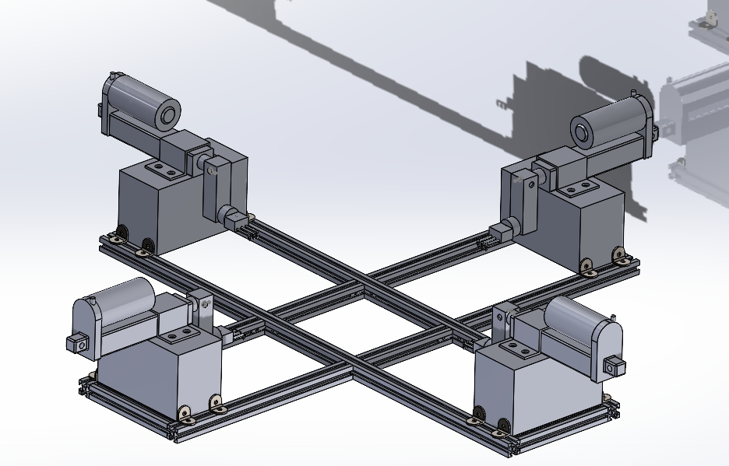
Reminder of our Project
Goal Statement
The Biaxial Tensile Tester is a device that will test and record the strength of skin, organs and other organic tissues while having constant velocity in the x and y direction.
Objectives
Pull tissue with the same velocity
Measure and display the force and displacement
Easy to operate
Portable
Slide 2

Slide 4
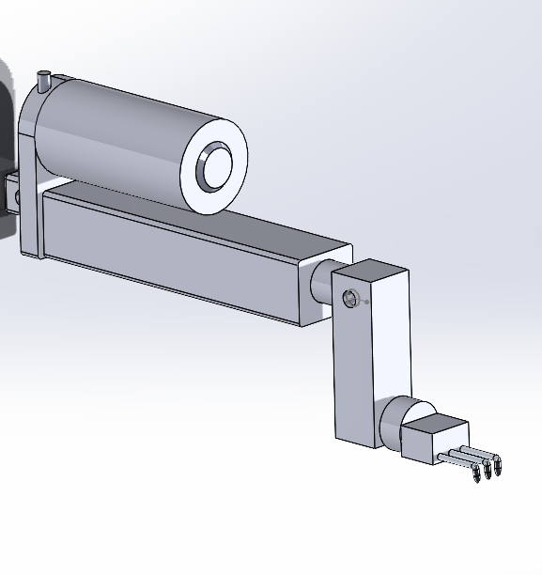
Update Since Last OPR
Both Actuators operate with single motor driver.
Pseudo code ready for synchronous working of Load cell and Actuator.
Works perfectly with the power supply.
The base and framework for one direction.(Brackets need to be tighten for the actuators)
Slide 4

Slide 5
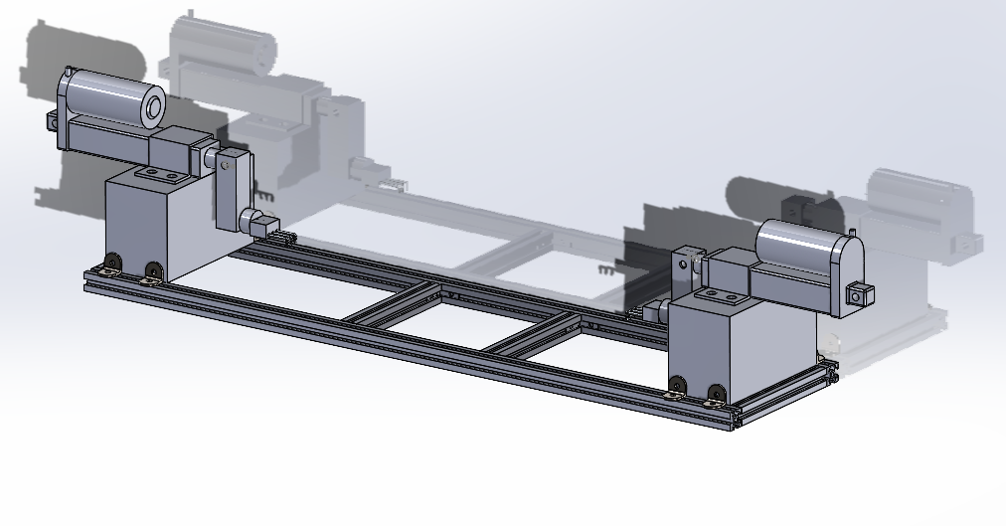
Milestone 2 Plans
Construct half of the tensile tester for Milestone 2
Have both the load cell and linear actuators working in synchronous
Have a final plan for Interface
Slide 5

Slide 6
Conclusion
By Milestone 2, one direction of tester will be ready
Readings for actuator and load cell will be accurate
Will have started on the interface prior to Milestone 2
We will also have a data storage to save all our data.
Slide 6

Slide 7
Summary
Overview
Update since last OPR
Milestone 2 Plans
Challenges for Milestone 2
Conclusion
Slide 7

Slide 8
Questions?
Slide 8

